Slide 1

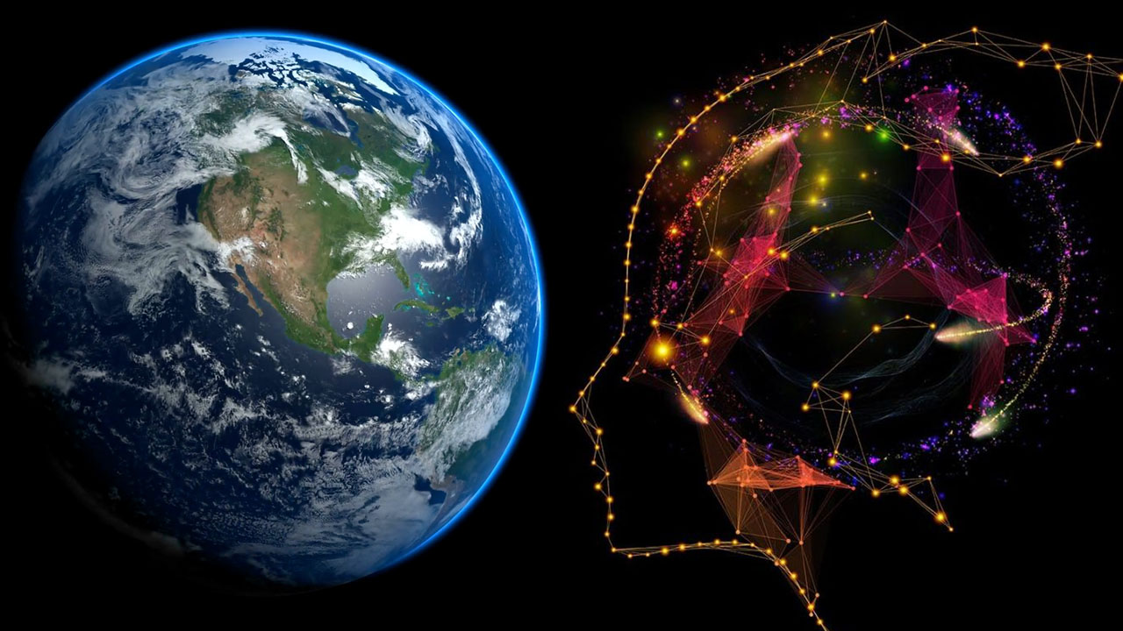
Spatial Machine Learning
Introduction to Spatial Data and Machine Learning
Dr. Giri Rajasekhar Gunnu
Professor of Practice, Andhra University
📧 g.giri.iitm@gmail.com
🔗 LinkedIn: girigunnu

Slide 2
(for Machine Learning)
Pre-Processing Spatial Data
1

Slide 3
What is Feature Engineering?
Concept:
The process of using domain knowledge to create new input variables (features) from raw data to improve machine learning model performance.
Quote:
"Coming up with features is difficult, time-consuming, requires expert knowledge. 'Applied machine learning' is basically feature engineering." - Andrew Ng
It's how we make our data speak the language of our model.

Slide 4
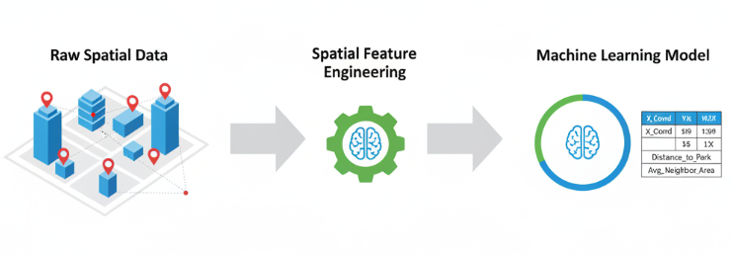
Why is it CRITICAL for Spatial Data?
Raw spatial data (like coordinates or polygons) is often not directly usable by standard machine learning algorithms.
The most important information is not just what the feature is, but where it is in relation to other features.
Feature engineering is how we explicitly encode this "whereness"—the spatial context—into a format our models can understand.

Slide 5
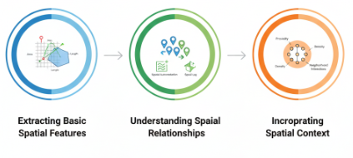
Topic Overview: What We Will Cover
Extracting Basic Spatial Features: Deriving metrics directly from geometric shapes (points, lines, polygons).
Understanding Spatial Relationships: Introducing the concepts of spatial autocorrelation and spatial lag.
Incorporating Spatial Context: Creating advanced features based on proximity, density, and neighborhood interactions.

Slide 6
Learning Goals & Objectives
Objective 1 (Theory): Understand the fundamental principles of spatial feature engineering and why it is a critical step in the spatial machine learning pipeline.
Objective 2 (Theory): Grasp the concept of spatial autocorrelation and its implications for model building (Tobler's First Law).
Objective 3 (Practical): Learn to extract geometric features from vector data (e.g., area, length, density).
Objective 4 (Application): Develop skills to create context-aware features, such as distance to nearest points of interest, buffer-based counts, and spatial lag variables.

Slide 7
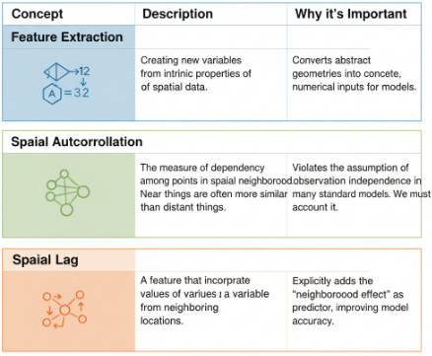
Key Concepts

Slide 8
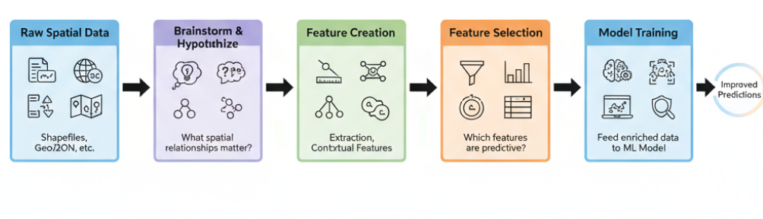
The Feature Engineering Workflow

Slide 9
Extracting Spatial Features

Slide 10
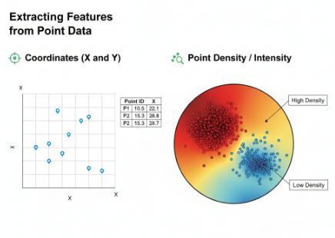
Extracting Features from Point Data
Concept: Points are the simplest geometry, but we can still derive powerful features.
Key Features:
Coordinates (X and Y)
Point Density / Intensity

Slide 11
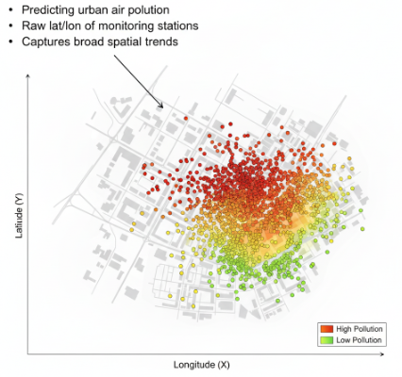
Example: Coordinates as Features
Scenario: Predicting urban air pollution levels.
Feature: The raw latitude (Y) and longitude (X) of monitoring stations.
Why: Even simple coordinates can capture broad spatial trends (e.g., pollution might be higher in the eastern part of the city).
(Visualization): A map of a city with points scattered across it.

Slide 12
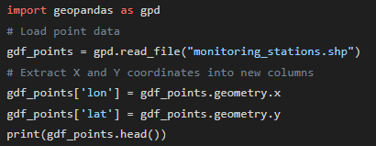
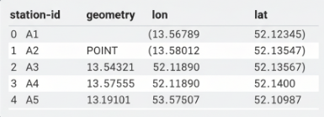
Python Code: Extracting Coordinates

Slide 13
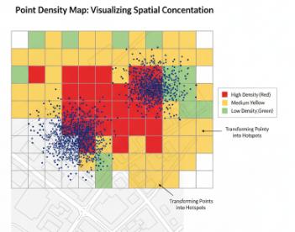
Concept: Point Density
Definition: Measures the concentration of points within a given area.
How it Works: Overlay a grid on your study area and count the number of points that fall into each grid cell.
Application: Identifying "hotspots" of crime, disease outbreaks, or retail store locations.

Slide 14
Case Study: Crime Hotspot Analysis

Slide 15
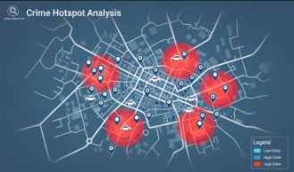
Case Study
Scenario: An urban planning department wants to understand the spatial distribution of reported thefts to allocate police resources more effectively and inform property value models.
Objective: To transform raw point data of crime incidents into a meaningful "crime density" feature that can be used in a machine learning model.
Raw Dataset: A shapefile containing the point locations (latitude, longitude) of thousands of reported thefts over the last year.

Slide 16
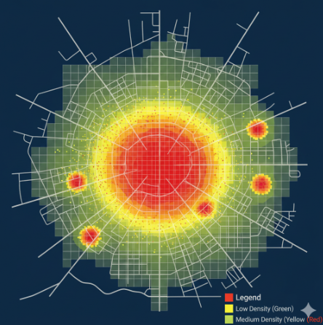
The Problem: Raw Data is Overwhelming
Concept: When plotted, the raw point data is a cloud of thousands of individual incidents. This is often called a "point swarm."
Challenge: While we can see some areas have more points than others, it's visually cluttered. It's impossible to quantify the density or extract a clear, numerical pattern that a machine learning model can use. Our eyes can guess, but a model needs numbers.

Slide 17
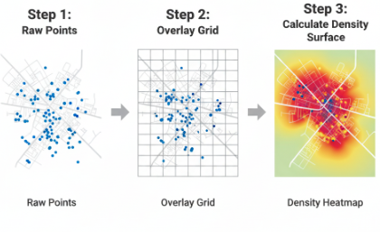
The Method: Creating a Density Grid (Kernel Density Estimation)
Conceptual Process: We can create a continuous surface that represents the concentration of points. This process is called Kernel Density Estimation (KDE).
Step-by-Step Flow:
Overlay a Grid: A fine grid of pixels (e.g., 10m x 10m) is laid over the entire study area.
Calculate Density: For each pixel, the algorithm calculates a density value based on how many points are nearby. Points closer to the pixel's center have more influence than points farther away.
Assign Value: Each pixel is assigned a numerical value representing its calculated density, creating a new raster layer.

Slide 18
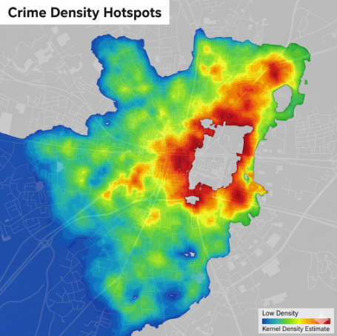
The Result: A Kernel Density Heatmap
Visualization: The output of the KDE process is a raster heatmap. This provides a powerful and intuitive visualisation of the crime distribution.
Interpretation:
"Hot" Colors (Red, Orange, Yellow): Indicate areas with a high concentration of crime incidents. These are the "hotspots."
"Cold" Colors (Green, Blue): Indicate areas with a low concentration of incidents.

Slide 19
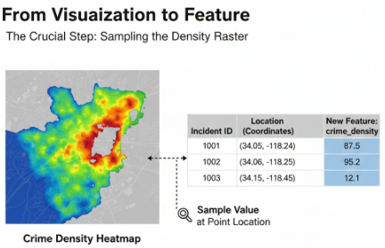
Creating the 'crime_density' Feature
The Crucial Step: A heatmap is great for humans, but a model needs a number. We now use this density raster to create our new feature.
Process: For each original crime incident point, we sample the value of the density layer at its exact location. This value becomes our new feature.

Slide 20
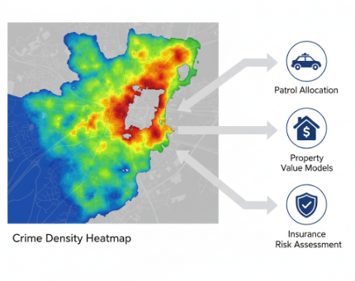
Case Study Summary & Application
What We Achieved: We successfully transformed thousands of raw location points into a powerful, context-aware numerical feature: crime_density.
How this feature is used in Machine Learning:
Predicting Property Values: The crime_density at a house's location can be a strong negative predictor of its price.
Resource Allocation: A model can use this feature to predict where future crime clusters are likely to emerge, helping the police department plan patrols.
Risk Assessment: Insurance companies can use this feature to model risk for different neighborhoods.

Slide 21
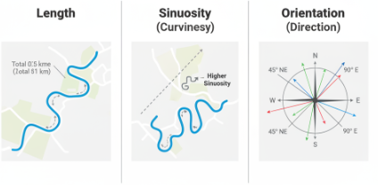
Extracting Features from Line Data
Concept: Lines represent linear features like roads, rivers, or utility networks.
Key Features:
Length
Sinuosity (Curviness)
Orientation (Direction)

Slide 22
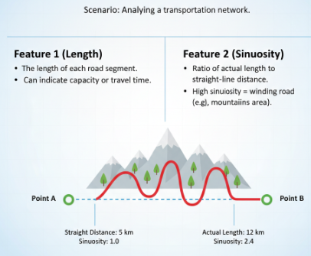
Example: Length and Sinuosity
Scenario: Analyzing a transportation network.
Feature 1 (Length): The length of each road segment. Can indicate capacity or travel time.
Feature 2 (Sinuosity): The ratio of the line's actual length to the straight-line distance between its endpoints. High sinuosity means a winding road (e.g., in a mountainous area).

Slide 23
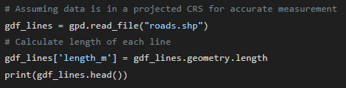
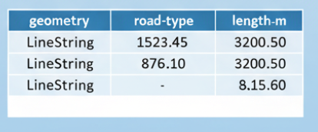
Calculating Length with GeoPandas

Slide 24
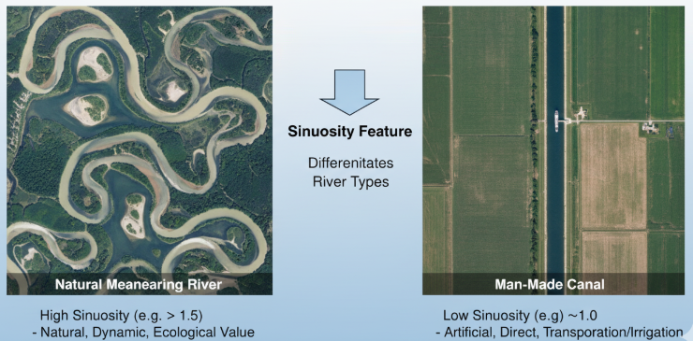
Application: River Network Analysis

Slide 25
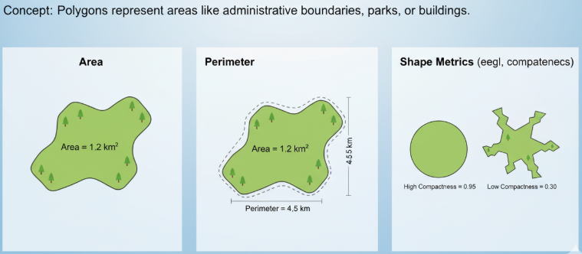
Extracting Features from Polygon Data
Concept: Polygons represent areas like administrative boundaries, parks, or buildings.
Key Features:
Area
Perimeter
Shape Metrics (e.g., compactness)

Slide 26
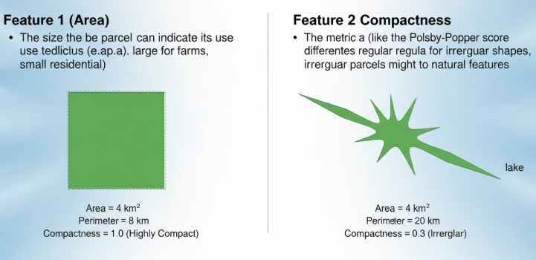
Example: Area and Compactness
Scenario: Classifying land use parcels.
Feature 1 (Area): The size of the parcel. Large parcels might be farms, small ones might be residential.
Feature 2 (Compactness): How compact or irregular a shape is. A common measure is the Polsby-Popper score. Irregularly shaped parcels might be natural features like lakes.

Slide 27
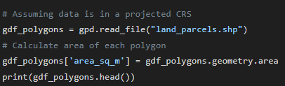
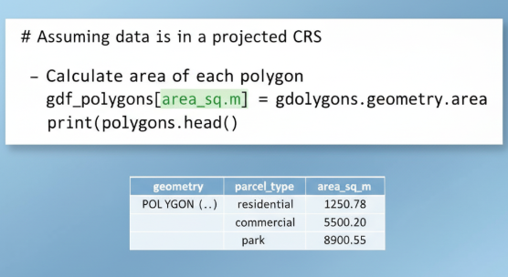
Calculating Area with GeoPandas

Slide 28
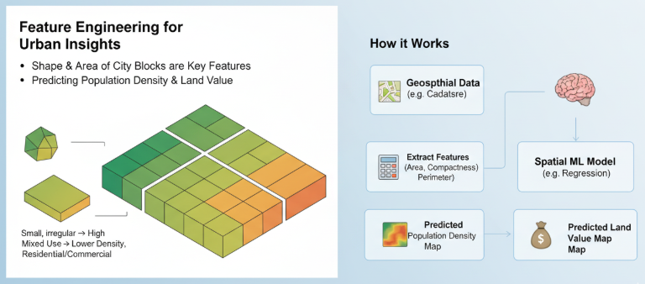
Application: Urban Planning

Slide 29
Spatial Autocorrelation & Spatial Lag

Slide 30
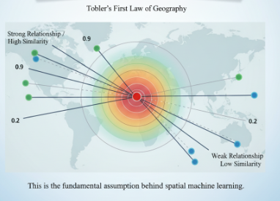
The Core Principle of Spatial Analysis
Tobler's First Law of Geography:
"Everything is related to everything else, but near things are more related than distant things.“
This is the fundamental assumption behind spatial machine learning.

Slide 31
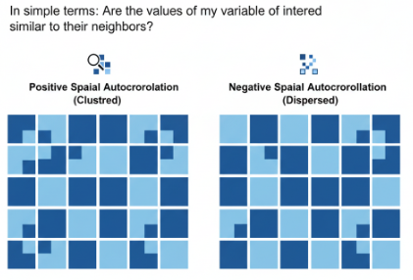
What is Spatial Autocorrelation?
Definition: A measure of the degree to which a set of spatial features and their associated data values are clustered together (positive) or dispersed (negative) in space.
In simple terms: Are the values of my variable of interest similar to their neighbors?

Slide 32
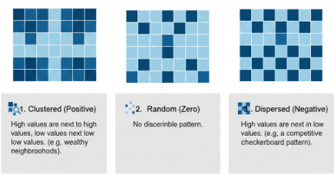
Visualising Spatial Autocorrelation
Clustered (Positive): High values are next to high values, low values next to low values. (e.g., wealthy neighborhoods).
Random (Zero): No discernible pattern.
Dispersed (Negative): High values are next to low values. (e.g., a competitive checkerboard pattern).

Slide 33
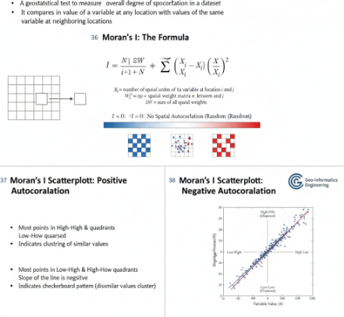
Measuring Spatial Autocorrelation: Moran's I
Clustered (Positive): High values are next to high values, low values next to low values. (e.g., wealthy neighborhoods).
Random (Zero): No discernible pattern.
Dispersed (Negative): High values are next to low values. (e.g., a competitive checkerboard pattern).

Slide 34
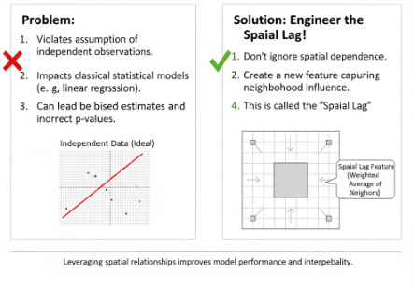
Why Does Autocorrelation Matter for ML?
Problem: It violates the assumption of independent observations, which is central to many classical statistical models (like linear regression).
Solution: We don't ignore it; we use it. We can engineer a feature that explicitly captures this neighborhood effect. This feature is called the Spatial Lag.

Slide 35
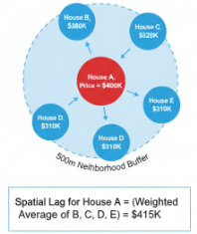
Concept: The Spatial Lag
Definition: For a given feature, its spatial lag is the weighted average of the feature's values in its neighborhood.
Example: The "spatial lag of house price" for House A would be the average price of all houses within 500 meters of House A.
It turns the "neighborhood context" into a numerical feature.

Slide 36
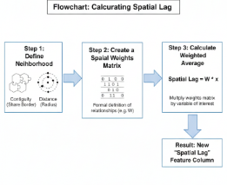
How to Calculate Spatial Lag (The Process)
Step 1: Define Neighborhood: How do we define "neighbor"?
Contiguity (e.g., polygons that share a border).
Distance (e.g., all points within a certain radius).
Step 2: Create a Spatial Weights Matrix: A matrix that formally defines the neighborhood relationships for every feature in the dataset.
Step 3: Calculate Weighted Average: Multiply the weights matrix by the variable of interest.

Slide 37
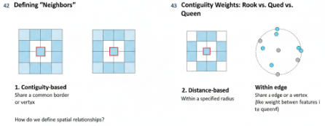
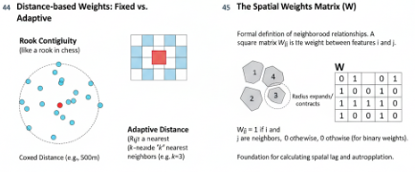
Deep Dive: Spatial Weights Matrix

Slide 38
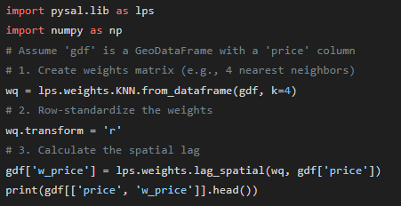
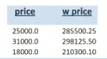
Calculating Spatial Lag with PySAL

Slide 39
Application Case Study: Real Estate Valuation
The Data: This map shows the actual sale prices for individual homes in a sample neighborhood. The data is visualized as a choropleth map, where each property parcel is colored by its value.
Color Scheme:
Light Yellow: Lower-priced homes.
Deep Red: Higher-priced homes.
Initial Observation: We can immediately see a strong spatial pattern. Prices are not random. This is positive spatial autocorrelation in action.
Expensive homes (red clusters) are located near other expensive homes.
Less expensive homes (yellow clusters) are grouped together.
Key Insight: This visual evidence confirms a core principle of real estate: a home's value is heavily influenced by the homes around it. A non-spatial model would miss this crucial context.

Slide 40
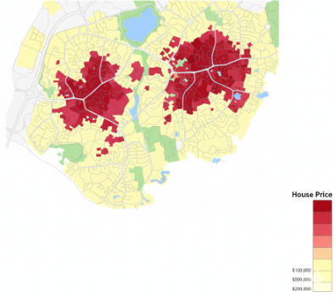
Application Case Study: Real Estate Valuation
The Engineered Feature: This map visualizes the spatial lag of the house prices. We'll call this new feature w_price.
What it Represents: Each property is now colored not by its own price, but by the average price of its immediate neighbors.
Visual Comparison:
Notice how this map is a "smoothed" version of the one on the previous slide.
The sharp, house-to-house differences are minimized, revealing broader "hot" (red) and "cold" (yellow) market zones.
The Purpose: We have successfully converted the abstract concept of "neighborhood value" into a concrete, numerical feature (w_price) that a machine learning model can understand.

Slide 41
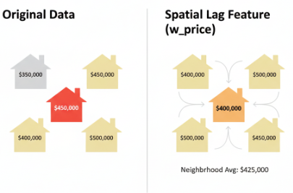
Application Case Study: Real Estate Valuation

Slide 42
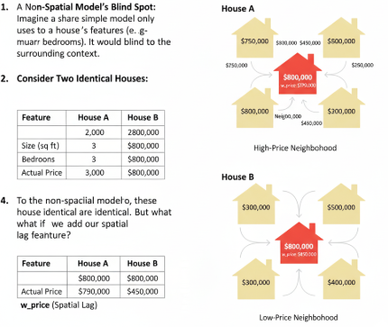
Application Case Study: Real Estate Valuation

Slide 43
Application Case Study: Real Estate Valuation
From Raw Data to Accurate Predictions
Improved Accuracy: By including w_price in our feature set, a regression model predicting house values will be significantly more accurate. It has now learned to account for the most famous rule in real estate: "location, location, location."
Better Insights: The model can now differentiate between price variations. It can better understand the value added by renovations versus the value derived purely from being in a desirable neighborhood.
Outlier Detection: This feature makes it much easier to automatically identify properties that are significantly over- or under-priced compared to their surroundings, which is valuable for investors and assessors.
Conclusion: We have successfully engineered the spatial context of the neighborhood into a single, powerful feature. This process of creating spatially-aware features is a cornerstone of effective Spatial Machine Learning.

Slide 44
Incorporating Spatial Context into Features

Slide 45
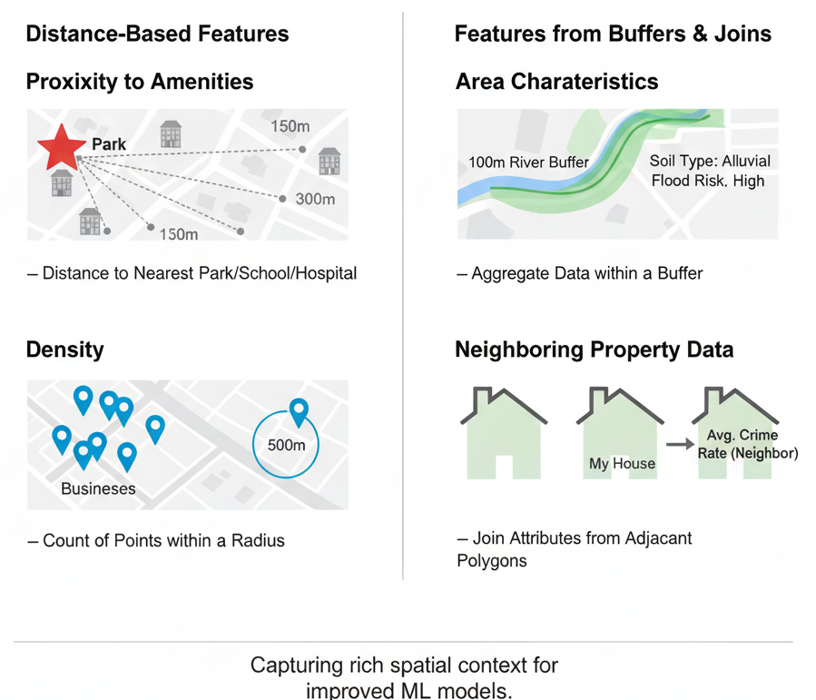
Beyond Spatial Lag: Other Contextual Features
We can create many other features that capture spatial context. The key is creativity and domain knowledge.
Main Categories:
Distance-based features
Features from Buffers & Joins

Slide 46
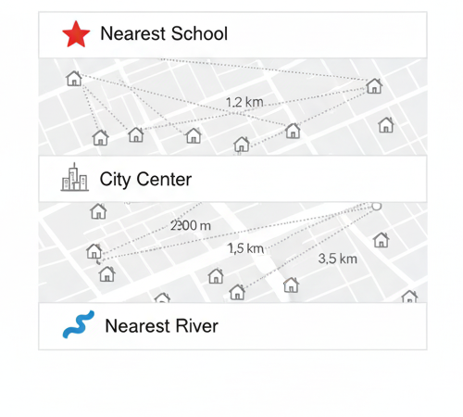
Distance-Based Features
Concept: Calculating the distance from each feature to a specific point of interest (POI).
Examples:
Distance from a house to the nearest school.
Distance from a retail store to the city center.
Distance from a farm to the nearest river.

Slide 47
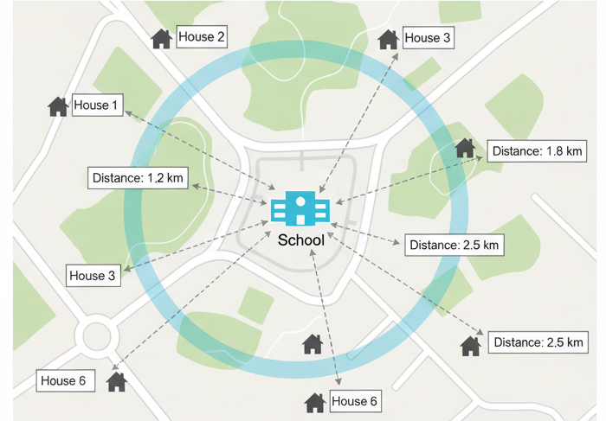
Distance-Based Features

Slide 48
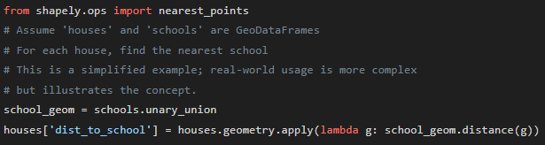
Python Code: Calculating Distance

Slide 49
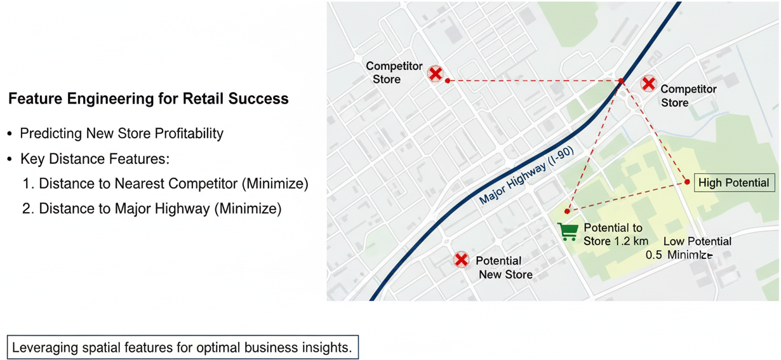
Application: Retail Site Selection

Slide 50
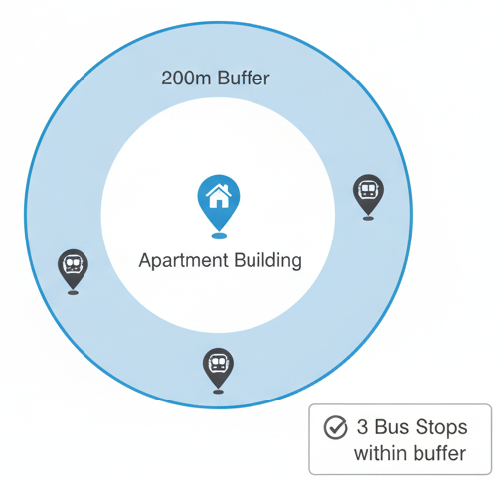
Buffer-Based Features
Concept: A buffer is a zone drawn around a spatial feature at a specified distance. We can then analyze what falls inside this zone.
Example:
How many bus stops are within a 200m walk from an apartment building?
What is the average income in the 1km radius around a proposed restaurant location?

Slide 51
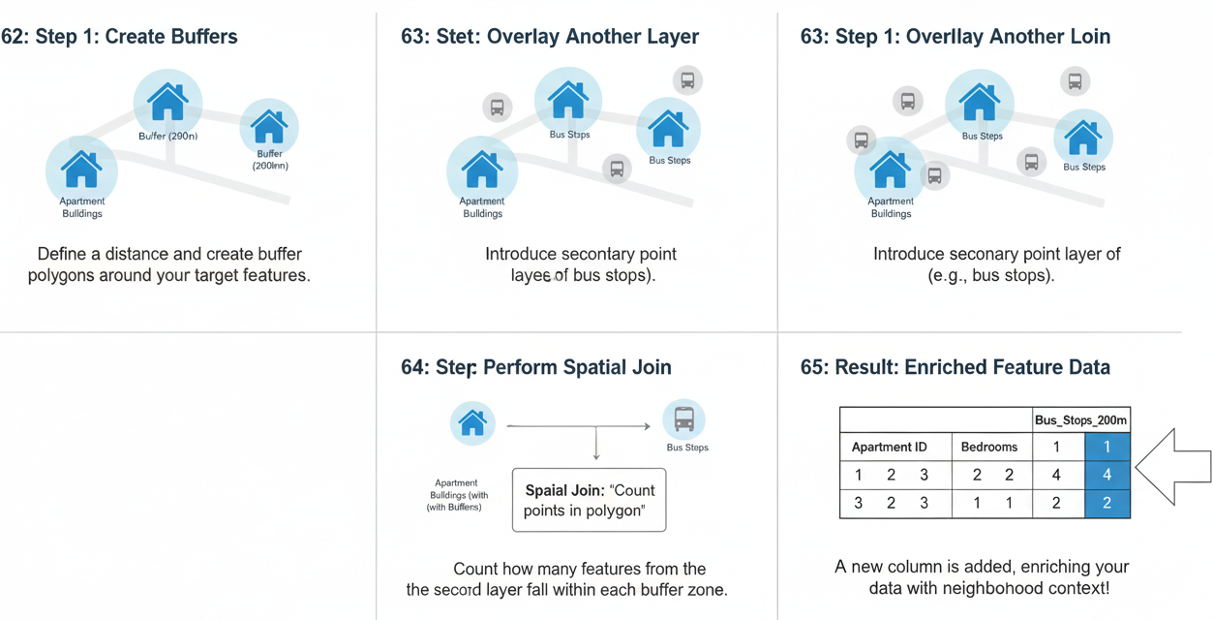
The Process: Buffering and Spatial Joins

Slide 52
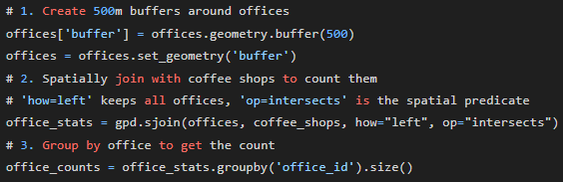
Python Code: Buffer and Spatial Join

Slide 53
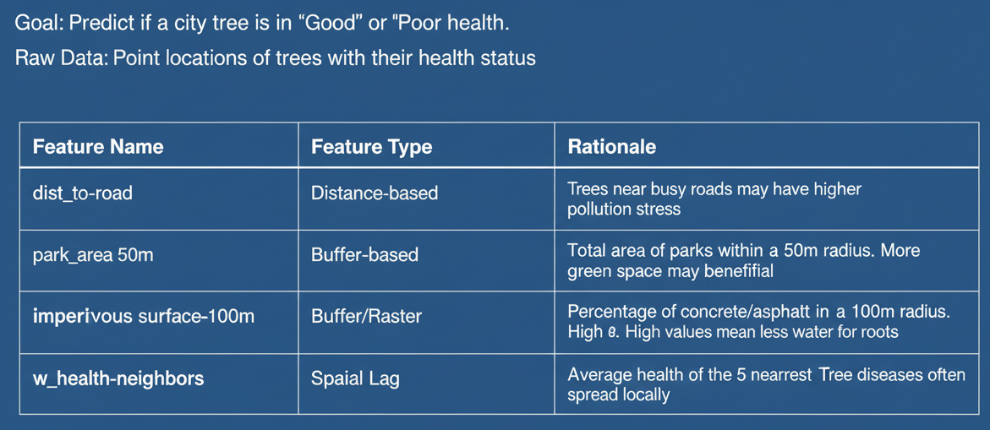
Case Study - Predicting Tree Health in a City

Slide 54
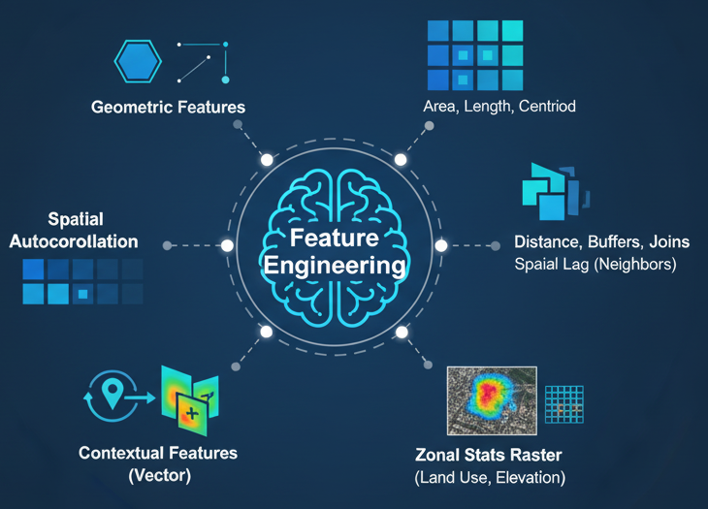
Topic Summary
Feature engineering is the most critical creative step in spatial machine learning.
We can extract features directly from geometry (area, length).
We must account for spatial autocorrelation, often by creating a spatial lag feature.
We can create powerful contextual features using distance, buffers, and spatial joins.

Slide 55

Myself
Dr. Giri Rajasekhar Gunnu
AI, Digital Twin & Industry Solutions Specialist | Industry 4.0 Specialist | Predictive Solutions Expert | Marine and Offshore Consultant
Professor of Practice, Andhra University
📧 g.giri.iitm@gmail.com
🔗 LinkedIn: girigunnu

Slide 56
Q&A
Welcome your questions and insights from all ranks
Your feedback helps us improve our CBPM implementation and ensures it meets the real-world needs of our fleet

